Slide 1

Mini Project-II
2021-22
COVID-19 TESTING MANAGEMENT SYSTEM

Slide 2
Submitted By
Rahul Chaudhary (191500620)
Shahrukh Khan (181500644)
Sachin Mishra (191500687)
Salman Alam(191500701)
UNDER THE SUPERVISION OF
Ms. Akash Kumar Chaudhary
(TECHNICAL TRAINER)

Slide 3
OBJECTIVES
As the COVID-19 crisis endures and the virus continues to spread globally, the need of data to store details of vaccination is increased.
for collecting epidemiological data and patient information also grows exponentially.

Slide 4
Hardware and Software Requirement
        Hardware Requirements
Processor : | Intel Dual Core or more
Processor Speed : | 1 GHZ
RAM : | 1 GB(Min)
Hard Disk : | 20 GB of free space
        Software Requirements
Operating System : Window 7 and higher
Front End : HTML, CSS
Back End : SQL Server, PHP
Software : Browser, Code editor , Xampp

Slide 5
Technology Used:
SQL: SQL is a structured query language used for querying database. MySQL is an open-source relational database management system. It will help in maintaining the customers record.
CSS: CSS is cascading style sheet which is used in designing webpages and help in creativity.
PHP: Hypertext Preprocessor is a server-side scripting language designed for web development but also used as a general-purpose programming language.
HTML: Hypertext Markup Language is the standard markup language for creating web pages and web application. HTML elements are the building blocks of HTML pages. With HTML constructs, image and other objects, such as interactive form.

Slide 6
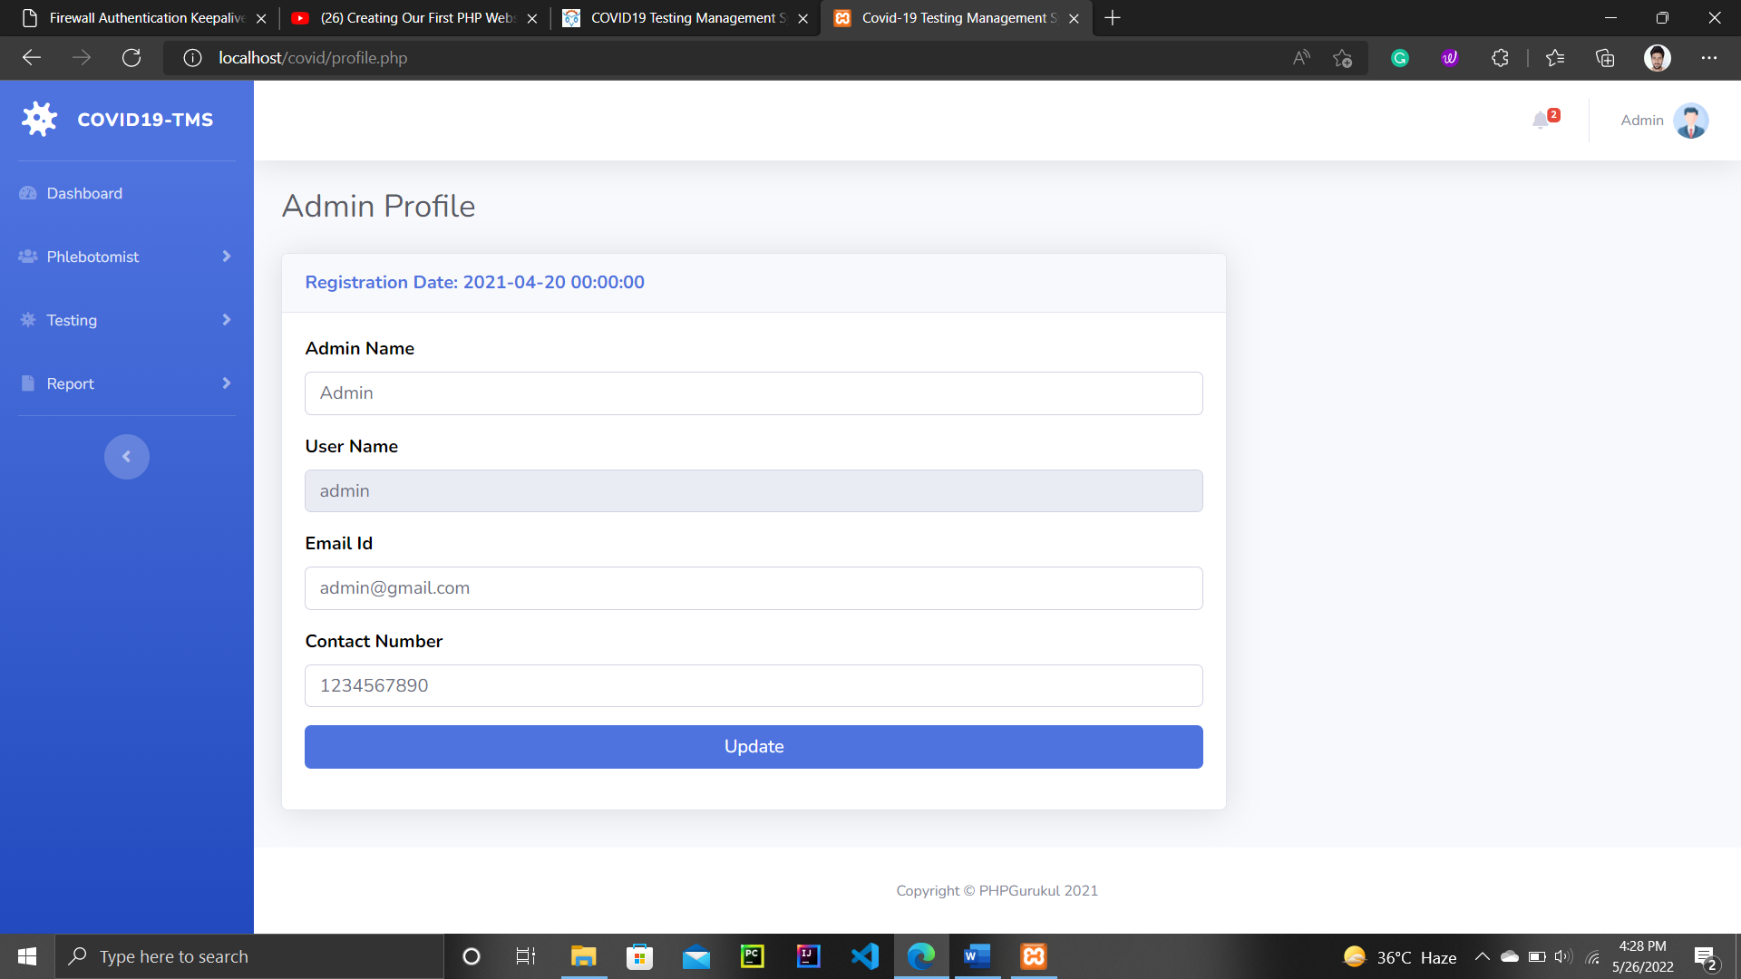
Let’s take a look at the website , Now!
This is admin login Page

Slide 7
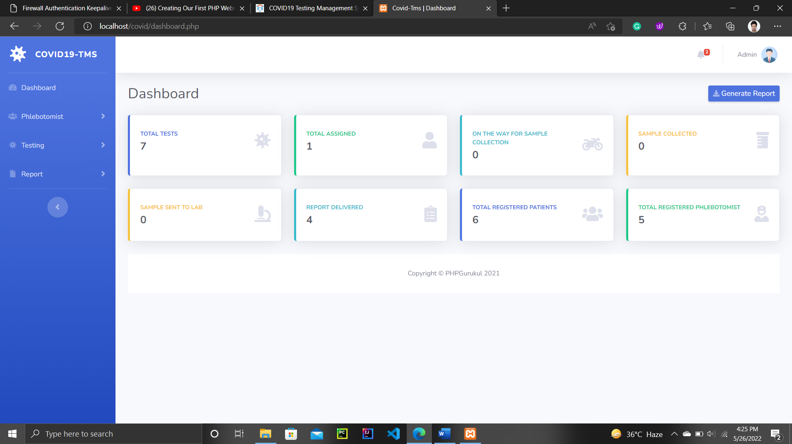
Home Page of Admin

Slide 8
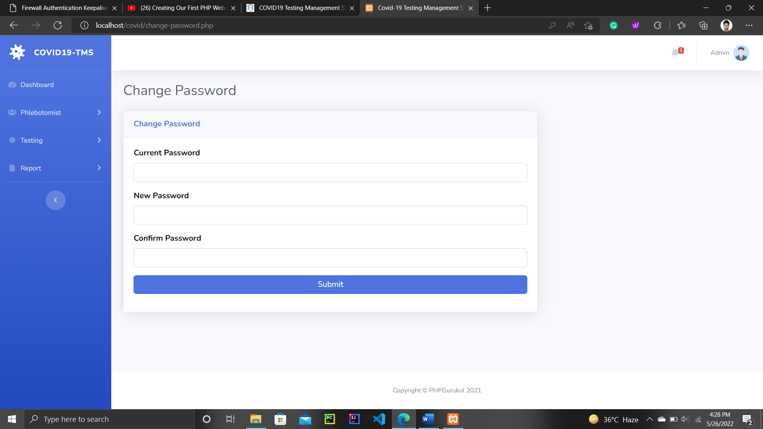
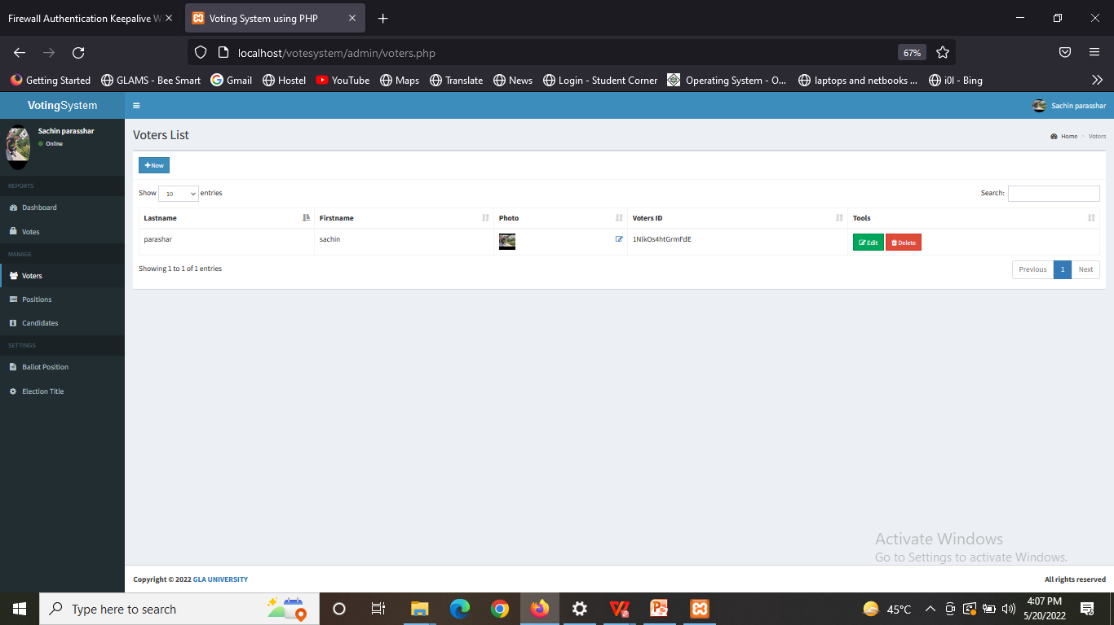
Change password page

Slide 9

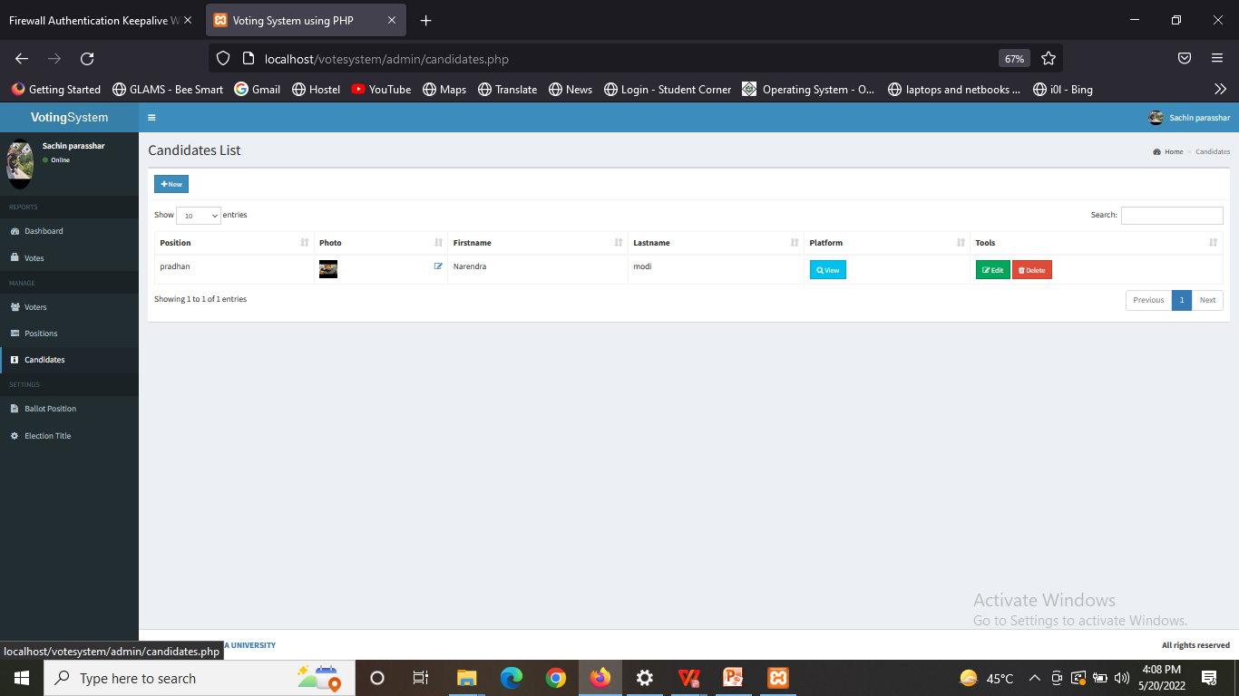
Add Test Report

Slide 10
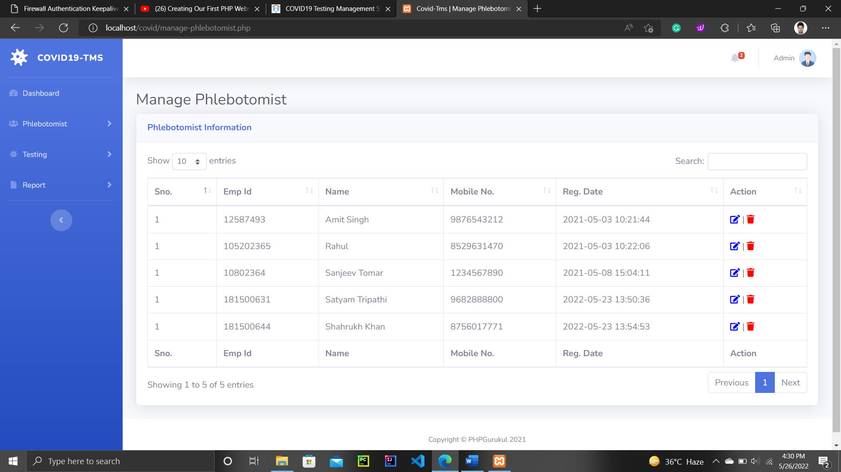
Add Testing Data

Slide 11
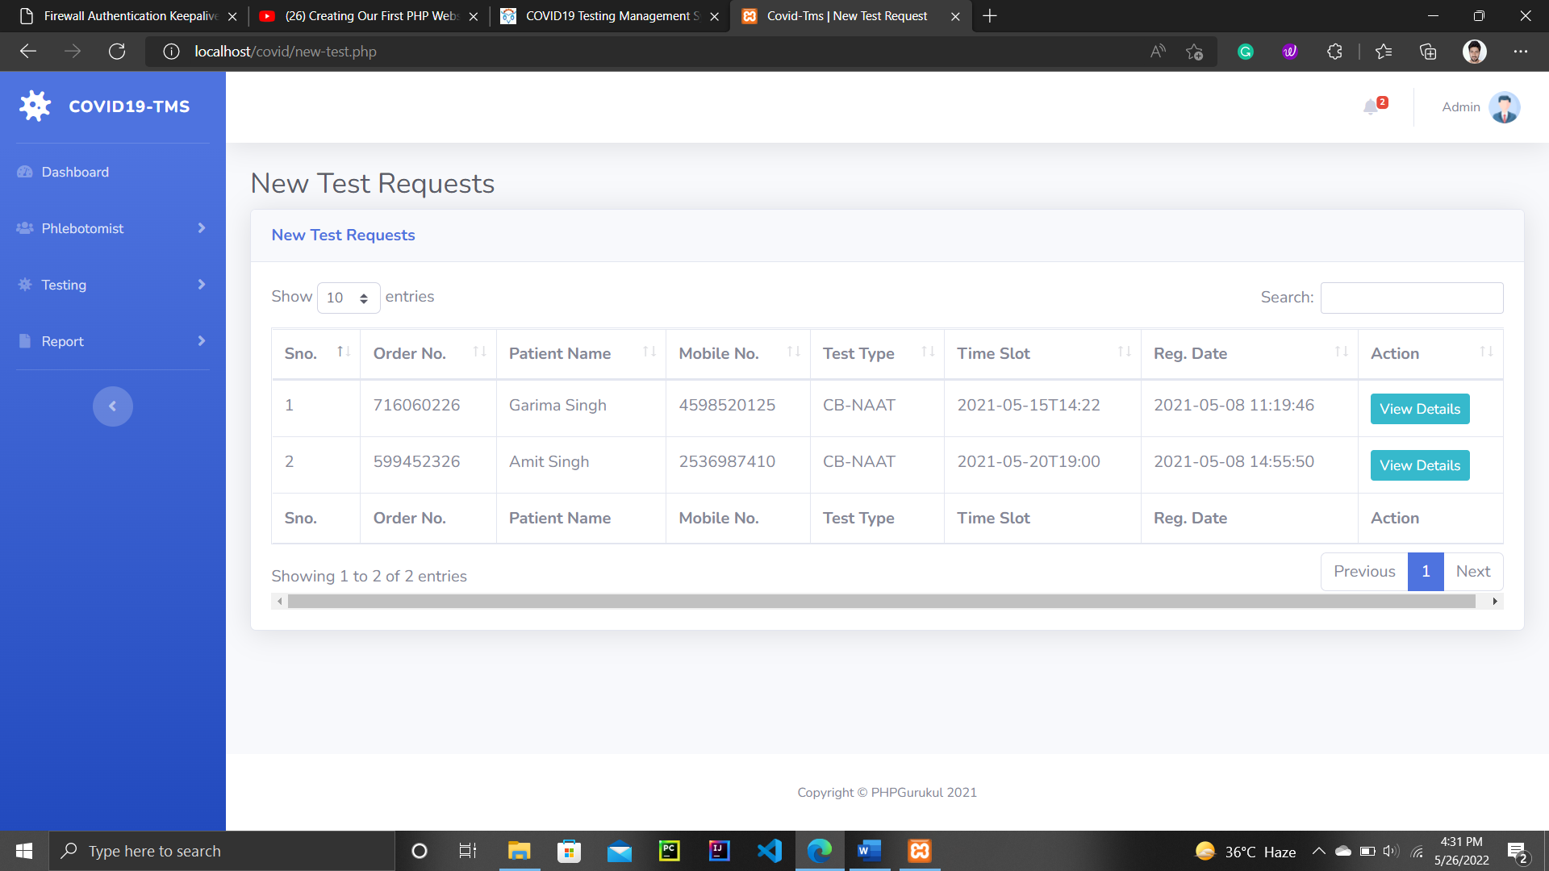
New Test Reqeust

Slide 12
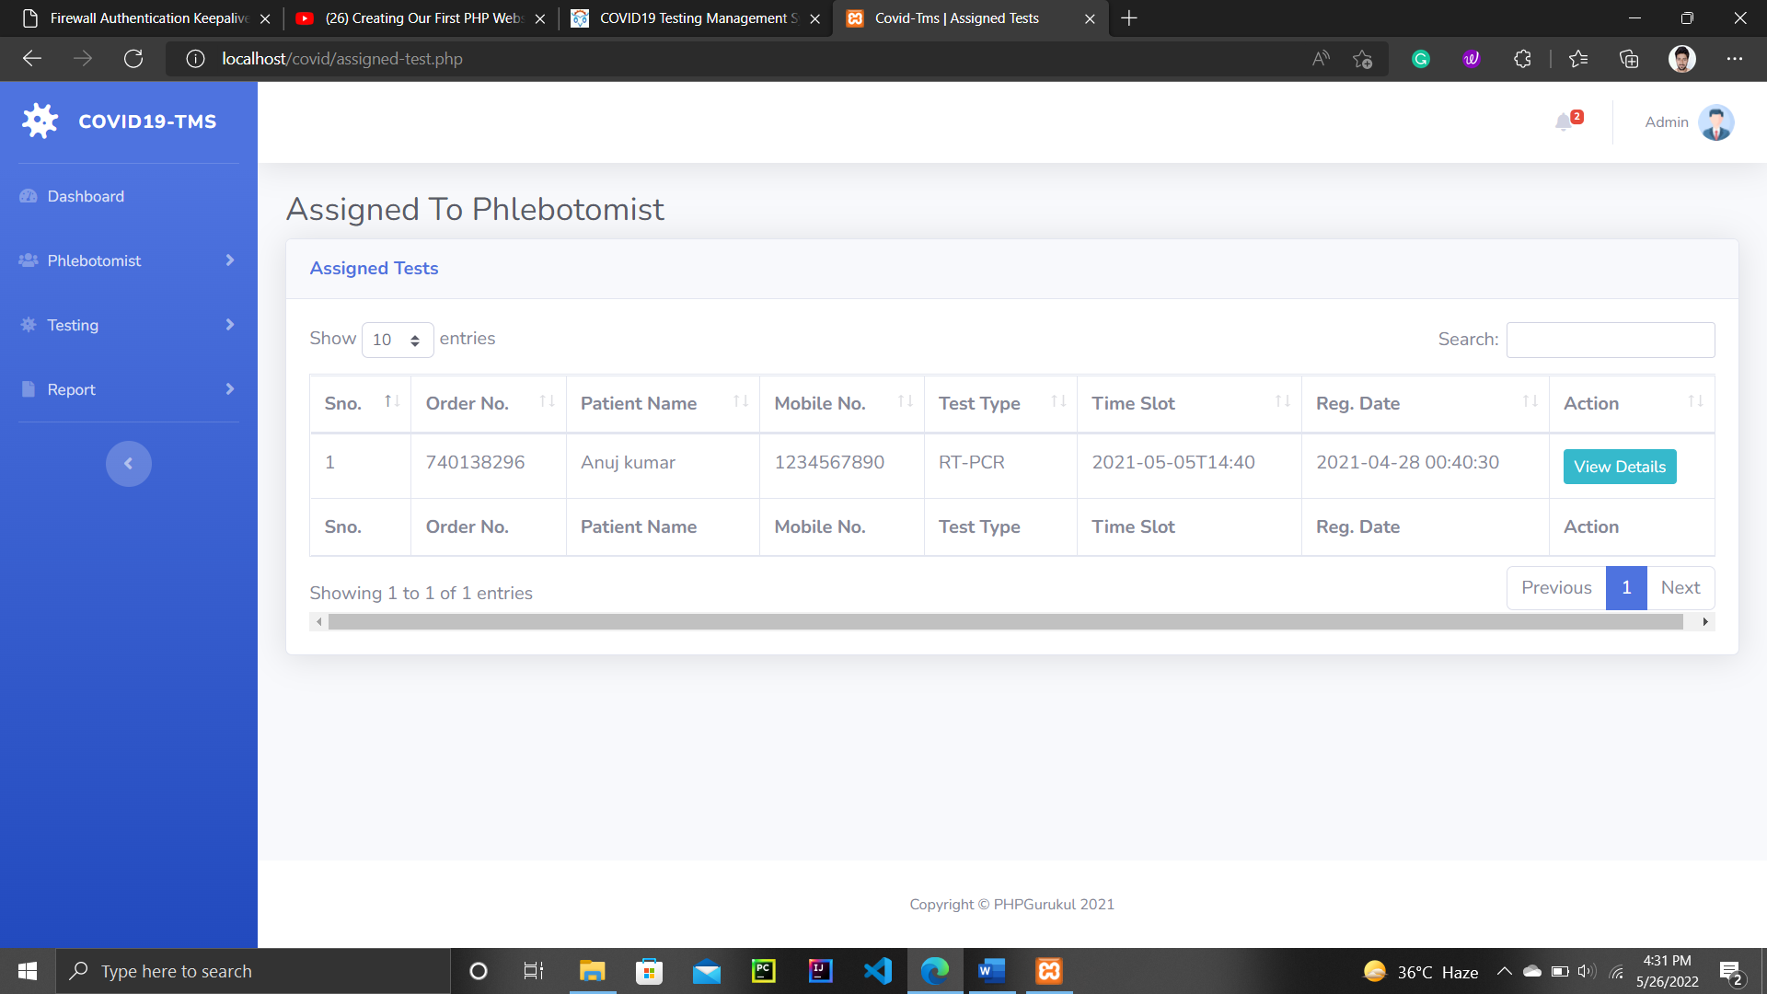
Assigned Test

Slide 13
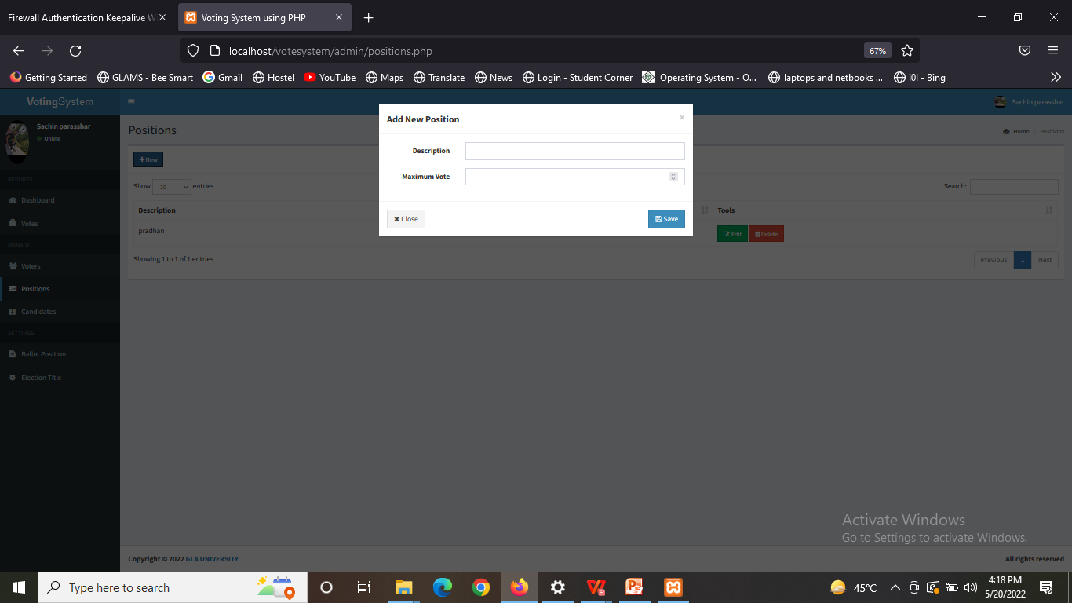
On The Way to Sample collect

Slide 14
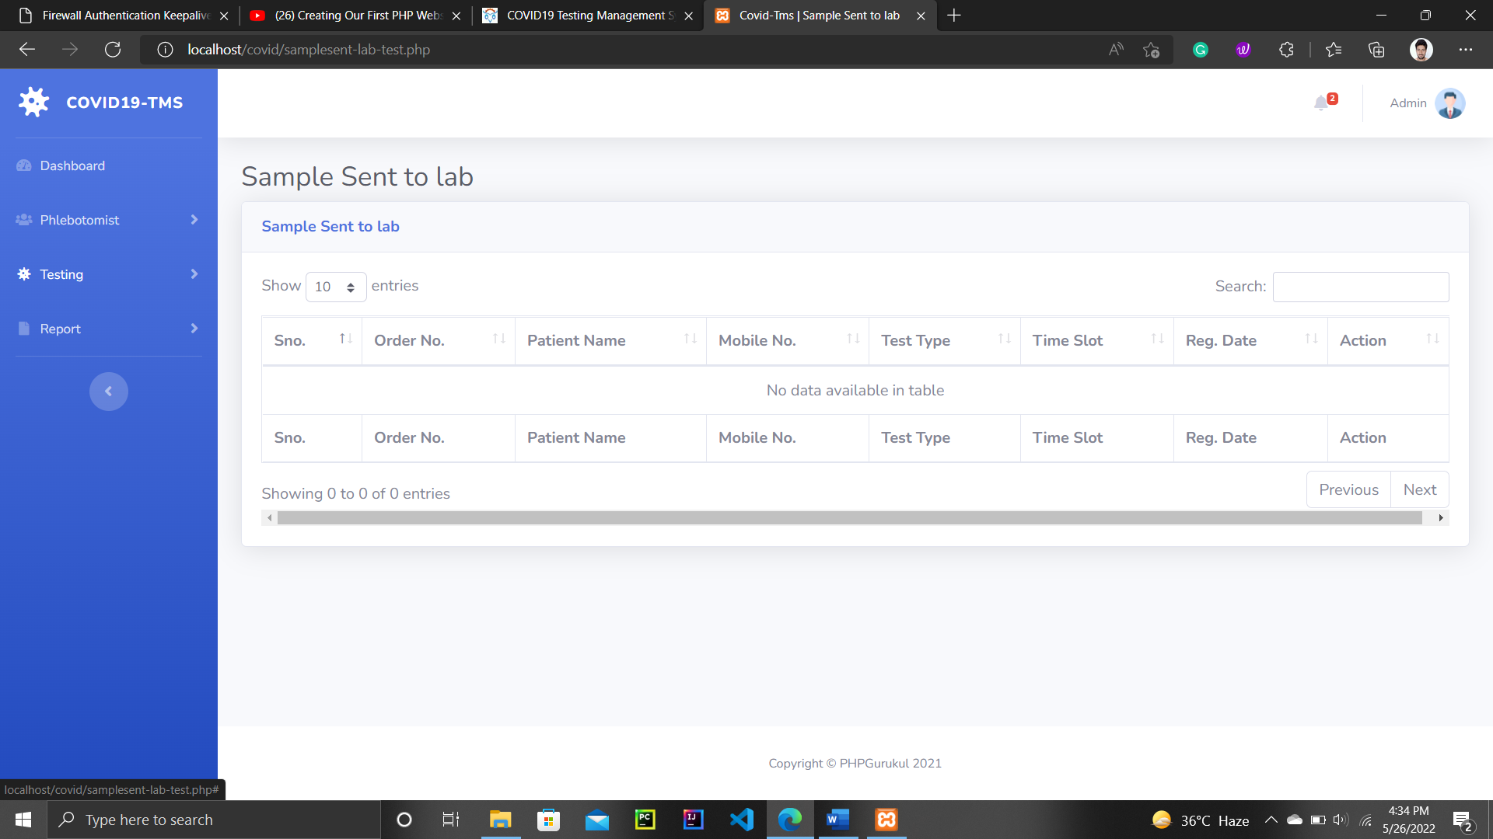
Sample sent to Lab

Slide 15
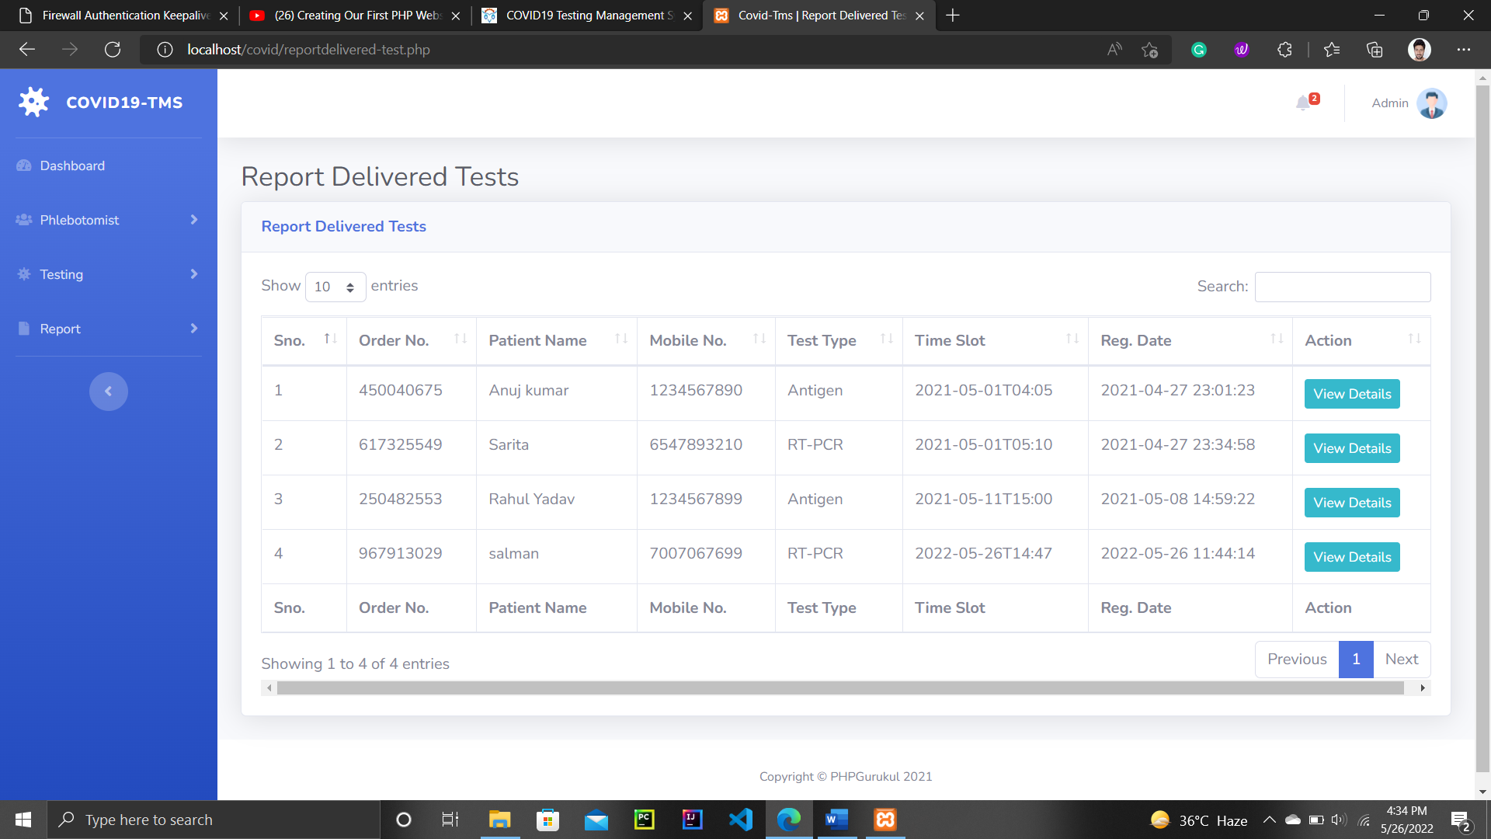
Report Deliverted

Slide 16
About XAMPP
XAMPP is an abbreviation where X stands for Cross-Platform, A stands for Apache, M stands for MYSQL, and the Ps stand for PHP and Perl, respectively.
XAMPP helps a local host or server to test its website and clients via computers and laptops before releasing it to the main server.
It is a platform that furnishes a suitable environment to test and verify the working of projects based on Apache, Perl, MySQL database, and PHP through the system of the host itself.

Slide 17
Future Scope
To track the data record of people who done with vaccination
And after it will take our portal to district level after it state level last to National level.

Slide 18
CONCLUSION
We are working on Covid-19 Testing Management Report, in which we are planning too collect data of different peoples from different region
We use this website to maintain the Covid reports that is generated after testing the Covid-19
User Can Also Check their report and even can download their report.

